Slide 1
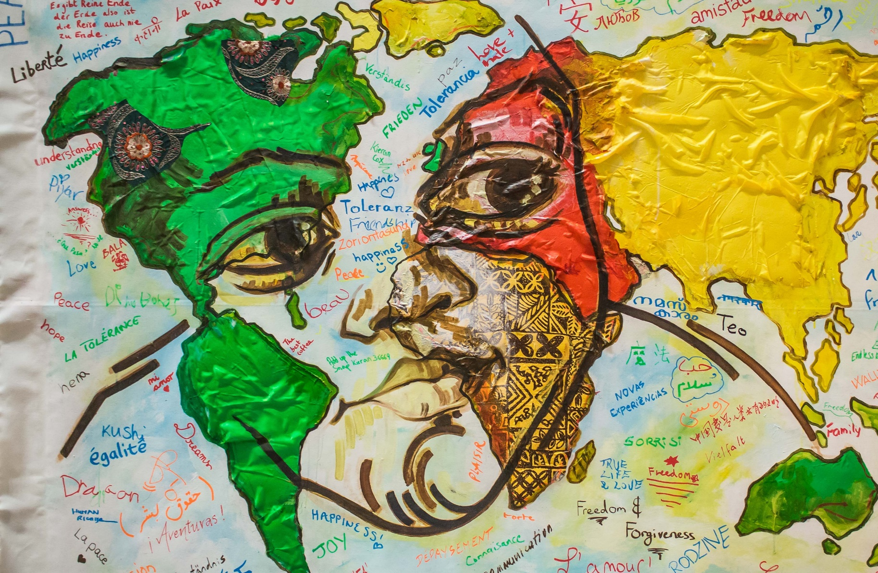

Reading Workshop:
French and Francophone Poetry

Slide 2
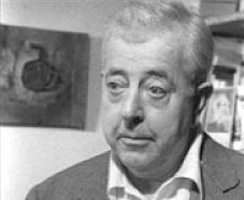
Jacques PréVert
Image (unchanged): The original uploader was PRÉVERT Catherine at French Wikipedia. [CC BY-SA (https://creativecommons.org/licenses/by-sa/1.0)]

Slide 3
‘Chant song’, by Jacques Prévert
Teacher to insert poem here. Can be found at: https://lesbellesphrases264473161.wordpress.com/2009/08/03/chant-song-jacques-prevert/

Slide 4
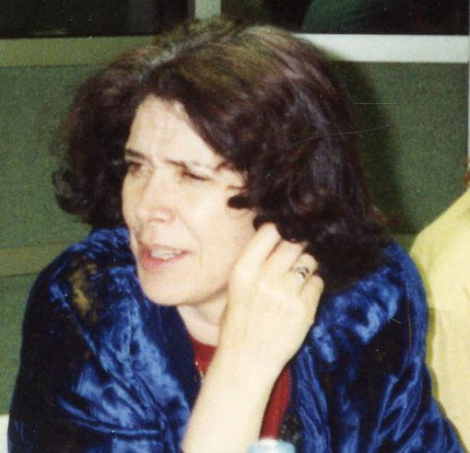
Assia Djebar (from Algeria, 1937-2015)
Image (unchanged): Michel-georges bernard [CC BY-SA (https://creativecommons.org/licenses/by-sa/3.0)]

Slide 5
Assia Djebar, Poèmes pour l’Algérie heureuse (1969)
Teacher to insert poem here. Can be found at: https://academic-oup-com.eres.qnl.qa/fs/article/67/2/216/519062

Slide 6
‘L’Exilé’, by Assia Djebar
Teacher to insert poem here. Can be found at: https://www.assolapres.fr/danielle-catala-et-abdelmadjid-kaouah-du-coeur-et-de-lame/

Slide 7
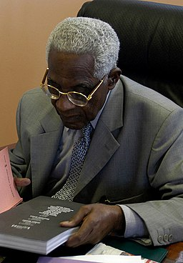
Aimé Césaire (from Martinique, 1913-2008)
Image (unchanged): Jean Baptiste Devaux [CC BY-SA (https://creativecommons.org/licenses/by-sa/4.0)]

Slide 8
‘Mot Macumba’, by Aimé Césaire from Moi, Laminaire (1982)
Teacher to insert poem here. Can be found at: http://www.unjourunpoeme.fr/poeme/mot-macumba

Slide 9
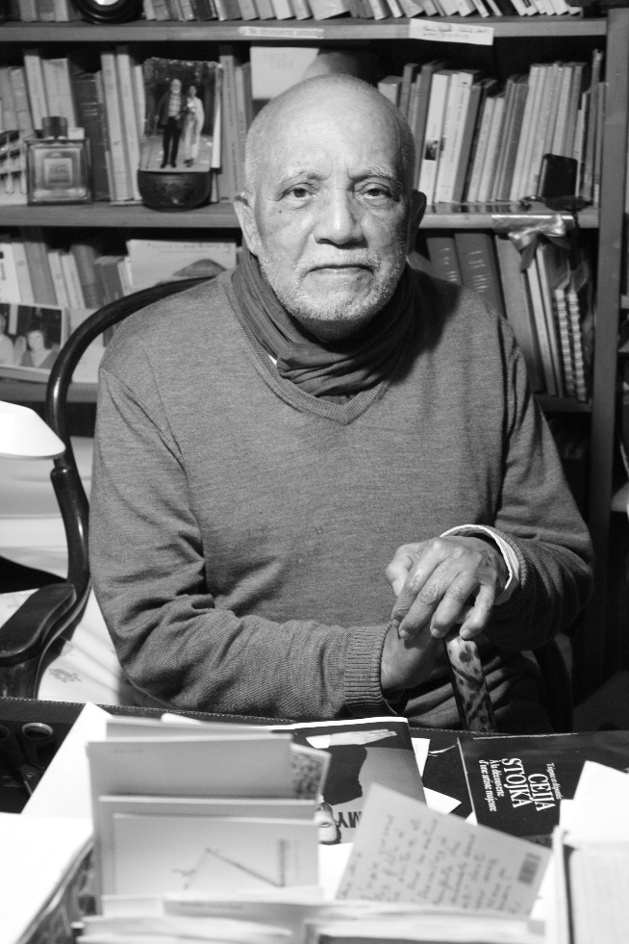
René Depestre (from Haiti, 1926-)
Image (unchanged): Etienne Rouziès [CC BY-SA (https://creativecommons.org/licenses/by-sa/4.0)]

Slide 10
‘En Fils Créole de la Francophonie’, by Réné Depestre
Teacher to insert poem here. Can be found at: https://www.poemes.co/en-fils-creole-de-la-francophonie.html

Slide 11
a poem in Verlan from the Banlieue ‘Double Culture’, unknown
Teacher to insert poem here. Can be found at:
http://docenti.unimc.it/valentina.tarquini/teaching/2016/16687/files/documenti-corso/poemes-en-verlan

